Slide 1

Lab 1.2 Example of Value Function
Notes:
1

Slide 2
Objectives
This lab is a basic example to illustrate how a value function can be implemented and initialized for a simple grid world environment. You are asked to implement the missing code.
Lab 1.2 Example of Value Function
2
Notes:
2

Slide 3
Lab Guide Coding
Using given code
The GridWorld class represents the grid world environment. It defines the grid size, the number of actions (up, down, left, right), and the rewards associated with each cell.
The ValueFunction class represents the value function. It stores the value estimates for each state in the grid world.
Lab 1.2 Example of Value Function
3
Notes:
3

Slide 4
Lab Guide Coding
Using given code
We initialize the value function with the rewards associated with each cell in the grid world.
We print the initial value function to see the value estimates for each state.
Lab 1.2 Example of Value Function
4
Notes:
4

Slide 5
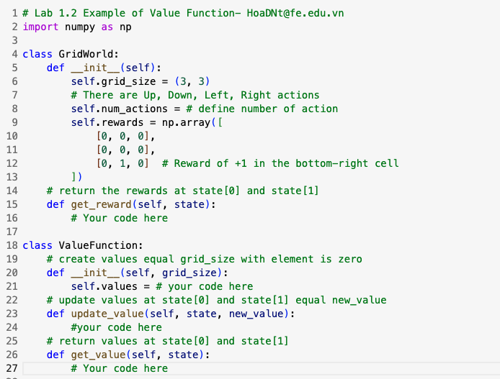
Lab Guide Coding
Lab 1.2 Example of Value Function
5
Notes:
5

Slide 6
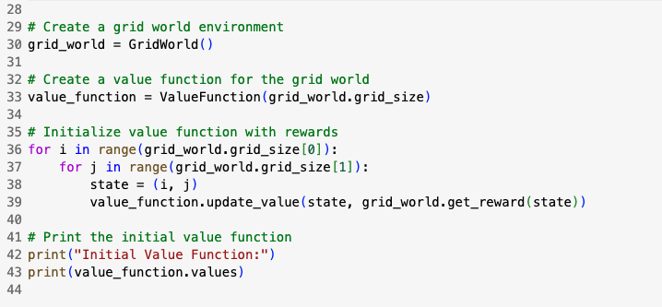
Lab Guide Coding
Lab 1.2 Example of Value Function
6
Notes:
6

Slide 7
Q & A
Lab 1.2 Example of Value Function
7

